Slide 1
A Comparison: Egyptian gods and the Ten Plagues on Egypt
By Benjamin Roe
Notes:
This is a comparison between some of the Egyptian gods and the ten plagues on Egypt. You can find this in Exodus chapters 7-11.

Slide 2
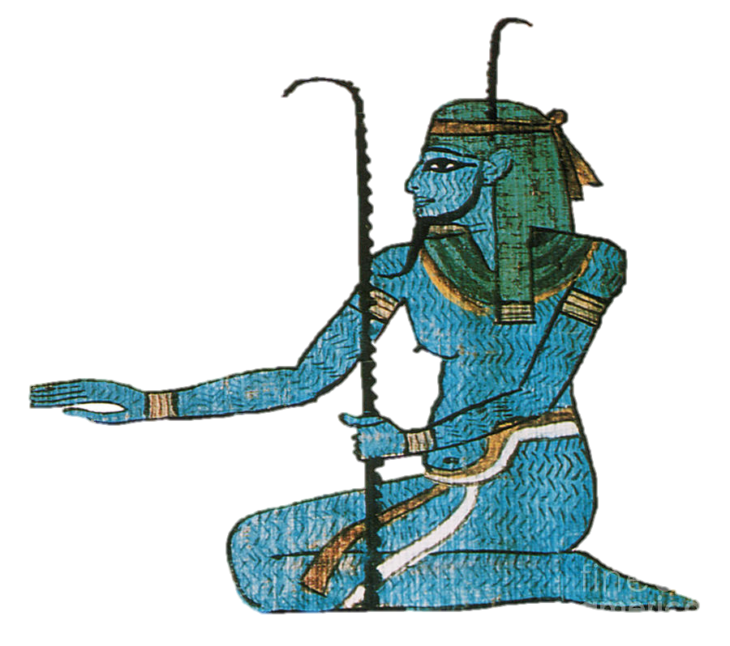
Hapi
god of the Nile.
The Plague:
The Plague of Blood – the Nile river turns into blood, from the point where Aaron placed his staff over the water.
Exodus 7:14 – 25
Notes:
The first plague on Egypt was the water of the nile turning to blood. Here we can see God’s power up agaist s[ecifically the Egyptian god Hapi, who was the god of the Nile.

Slide 3
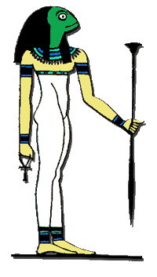
Heket
goddess of Frogs
The Plague:
The Plague of Frogs – frogs come out of the Nile and plague the towns.
Exodus 7:25, 8:1 – 16
Notes:
Heket was the goddess of frogs to the Egyptians. She had complete control over the frogs, but the plague of frogs showed the Egyptians, that perhaps their gods aren’t as powerful as they had thought.

Slide 4
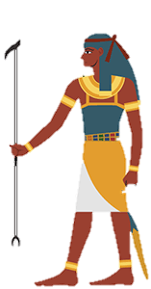
Geb
god of the earth
The Plague:
The Plague of gnats – gnats and flies came out of the ground and plagued the towns.
Exodus 8:16 – 20
Notes:
Similarly Geb was the god of the earth. In the plague of gnats, it is said that gnats and flies came up out of the earth, which only good things were meatn to come as long as geb was in control.

Slide 5
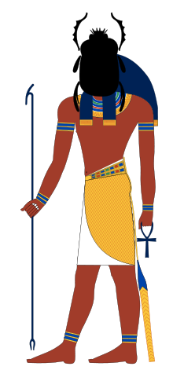
Khepri
god of scarab beetles (has the head of a fly)
The Plague:
The Plague of flies – flies plague the towns.
Exodus 8:20 – 32
Notes:
Egyptian god Khepri, sometime depicted as having the head of a flly, is the god of scarab beetles. The plague of flies show once more to the Egyptians how the God of Israel was the true god.

Slide 6
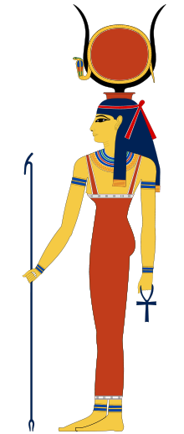
Hathor
goddess of love and protection
The Plague:
The Plague of the death of the livestock – all the livestock were struck dead.
Exodus 9:1 – 7
Notes:
The plague on the lilvestock can be linked to the goddess Hathor, because she is the goddess of love and protection, neither of which were able to defencd the livestock from the plague of death on them.

Slide 7
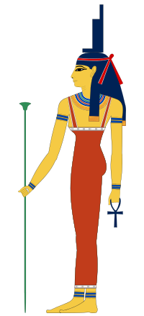
Isis
goddess of medicine and healing
The Plague:
The Plague of boils – all the Egyptians had boils appear all over their bodies.
Exodus 9:8 – 13
Notes:
Similar to Hathor and the plague on the livestock isis is the egptian goddess of medicine and healing. The plague of boils proved the Egyptians wrong as their goddess of medicine and healing was unable to relieve them or help them at all.

Slide 8
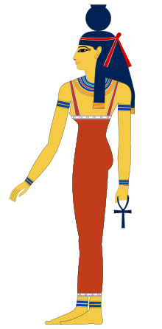
Nut
goddess of the sky and stars
The Plague:
The Plague of hail – large hail stones fell from the sky.
Exodus 9:13 – 34
Notes:
Nut is the Egyptian goddess of the sky and stars, who controls some aspects of the weather, however, she was unable to prevent the plague of hail, which was another reminder to the Israelites to hold their faith.

Slide 9
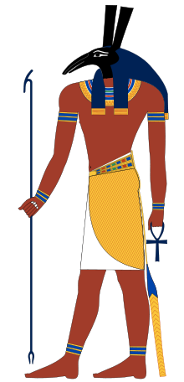
Seth
god of storms and chaos
The Plague:
The Plague of locusts – a plague of locusts ate the Egyptian’s crops.
Exodus 10:1 – 21
Notes:
Similar to nut, seth is the god of storms and chaos, the plague of the locusts was said to be from seth because at first the Egyptians though it was a storm coming, however, the storm that they wanted turned out quite different.

Slide 10
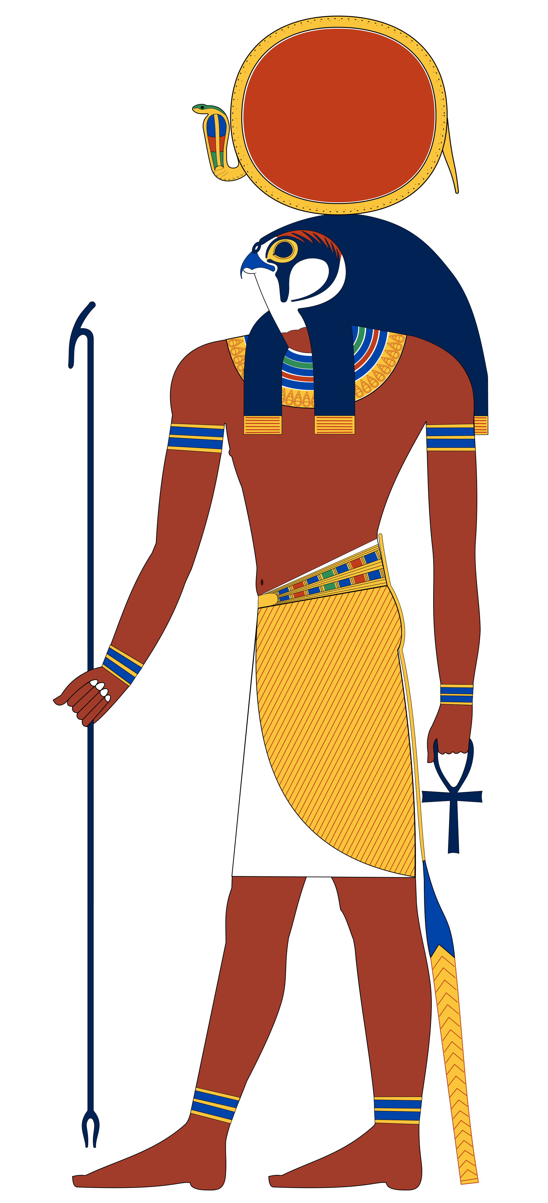
Ra
god of the Sun
The Plague:
The Plague of darkness – the land of Egypt was covered in darkness for three days.
Exodus 10:21 – 29
Notes:
Ra, the god of the sun can clearly be seen defeated with the Israelite’s God bringing three days of total darkness.

Slide 11
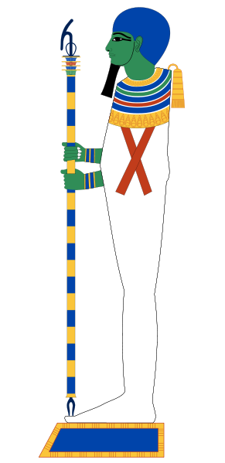
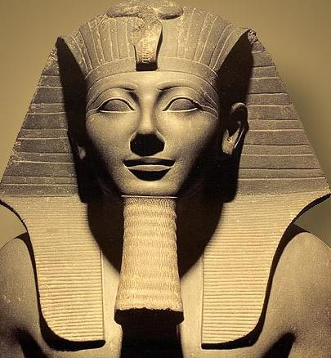
Ptah / Pharaoh
god of creation /
ultimate power of Egypt
The Plague:
The Plague on the firstborn – the firstborn son of each family died.
Exodus 11
Notes:
The plague of the firstborn was the final plague and showed both Ptah , the god of creation and pharaoh who was the real GOD.

Slide 12
Thanks for watching!
Notes:
Thanks you for watching, I hope you were able to get something out of this presentation.

